Slide 1
Hands-on Exercises
Performance Based Planning and use of IFSET
SIP/ASBU/Bangkok/2012-WP/32B
Workshop on preparations for ANConf/12 − ASBU methodology
(Bangkok, 14-18 May 2012)

Slide 2
Step 1 – Introduction
Names/Infrastructure
  Indicate name of your State and participants
  Provide a brief introduction to current infrastructure of your State

Slide 3
Step 2 – Block 0 Modules
Review 18 Modules of ASBU Block 0 :
  Determine the Modules and corresponding PIAs that are applicable to your State
  Refer to Doc 2. Appendix A as well as all Module PPTs for guidance

Slide 4
Step 3 – ANRF
Study Air Navigation Report Form (ANRF) template available in WP32A
Using WP32 A, Develop (fill-up) three ANRFs for any Block 0 Modules that you selected for your State in step 2

Slide 5
Step 4 – Metrics
Performance Metrics: Identify the relevant metrics that are suitable for monitoring the implementation status of those 3 ASBU Modules selected in step 3
For guidance on metrics list refer to WP32A and WP 6

Slide 6
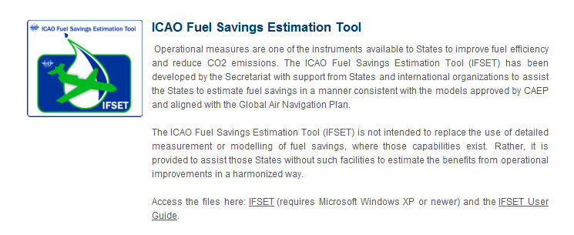
Step 5 – Download IFSET
Go to : http://www.icao.int/environmental-protection/Pages/Tools.aspx
Scroll to the bottom and download the iFSET

Slide 7
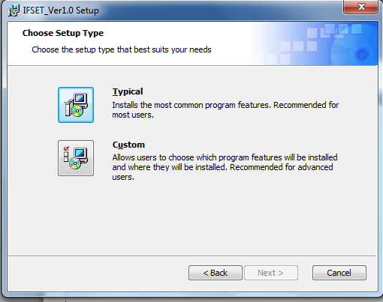
Step 6 – Download IFSET (cont.)
Un-zip the file and run the installation, choose the ‘typical’ option.

Slide 8
Step 7 – Run IFSET
Locate the IFSET and run the application for three operational improvements: CCO,CDO and PBN route.(Defined in next slide)
For each operational improvement do the following in IFSET
  Create an operations definition
  Describe the old procedure
  Describe the new procedure
  View the fuel estimation report and export to your folder
Indicate fuel savings and corresponding CO₂ reduction for the above 3 Operational Improvements

Slide 9
Step 7 – Run IFSET(Cont.)
Operations 1
Airport AAAA (ADEL 1000FT) is known by the restrictions to departures due to conflicting routes that impose restrictions to a continuous climb operation.
At this airport, B737-800 is the dominant aircraft type with 400 operations daily, but E-195 also operates at a rate of 50 daily operations. CL60 operates at 30 movements daily and C560 at a rate of 20 movements a day. The other operations of small aircraft are not representative. All aircraft will benefit of the new departure procedure.
The only SID in use is described as: From 1000FT, climb to 7000FT and maintain this altitude for 5NM. After that climb to 14000FT and maintain this altitude for 5 more miles, when the climb is unrestricted to the cruising flight level.
The new envisaged procedure will allow the aircraft to climb from 1000FT to the cruising flight level without restrictions.

Slide 10
Step 7 – Run IFSET (Cont.)
Operations 2
Airport BBBB (ADEL 3000FT) is known by the restrictions to approaches due to obstacles that impose restrictions to a continuous descend operation.
At this airport, B767 is the dominant aircraft type with 100 operations daily, but A340 also operates at a rate of 40 daily operations. A380 and A330 operate at 10 movements daily each. The rest of the operations are composed by B737-800 at a rate of 80 movements a day. The other operations of small aircraft are not representative. All aircraft will benefit of the new approach procedure.
To feed the runway dedicated to approach the single approach procedure is described as: After levelling for 10NM, descend from 10000FT to 7000FT, level for 5NM then descend from 7000FT to 3000FT.
The new envisaged procedure will allow the aircraft to descend continuously from 10000FT to 3000FT after the 15NM levelling at 10000FT.

Slide 11
Step 7 – Run IFSET (Cont.)
Operations 3
The conventional route linking cities A and B has 338NM of extension. After restructuring the airspace through the implementation of RNAV routes between the two cities, the new route will be reduced to 288NM.
At this route, B737-800 at a rate of 80 operations daily is the dominant aircraft, but E-195 also operates at a rate of 70 daily operations, B767 has 60 operations daily, A340 also operates at a rate of 30 daily operations. A330 operates at a rate of 20 daily movements. Small business jets, of different types respond for 15 operations on a daily basis and only 10 are RNAV approved. The other operations are not representative.
Except for the regional jets, which have as optimum flight level 31000FT, the other aircraft types all compete for FL350.

Slide 12
Step 8 – GIS Status
Calculate the percentage of airports for which CCOs and CDOs are implemented currently
On the GIS map (next slide) click on your State and change the color as follows
  0-50% Red
  50-75% Orange
  75-100% Green

Slide 13
Step 9 – GIS – CCO/CDO Current Status

Slide 14
Step 10 – Remarks
Your suggestions to improve the contents of ASBUs and the workshop are welcome.

Slide 15
ASBU BLOCK 0 MODULES AND CORRESPONDING BENEFITS

Slide 16
ASBU BLOCK 0 MODULES and BENEFITS
Modules of ASBU Block 0 | Access | Capacity | Efficiency | Environment | Safety
B0-65/PIA-1
B0-70/PIA-1
B0-75/PIA-1
B0-80/PIA-1
B0-15/PIA-1
B0-25/PIA-2
B0-30/PIA-2
B0-105/PIA-2
The eleven KPAs/Benefits are shown in alphabetical order as they would appear in English. They are access/equity; capacity; cost effectiveness; efficiency; environment; flexibility; global interoperability; participation of ATM community; predictability; safety; and security. However, out of these eleven KPAs, five have been selected for reporting, which are Access /Equity, Capacity, Efficiency, Environment and Safety.

Slide 17
ASBU BLOCK 0 MODULES and BENEFITS
Modules of ASBU Block 0 | Access | Capacity | Efficiency | Environment | Safety
B0-10/PIA-3
B0-35/PIA-3
B0-84/PIA-3
B0-86/PIA-3
B0-85/PIA-3
B0-102/PIA-3
B0-101/PIA-3
B0-05/PIA-4
B0-20/PIA-4
B0-40/PIA-4

Slide 18


